Slide 1

HOSPITAL MANAGEMENT USING FACE RECOGNITION
Presented by: Under the Supervision of:
Manasi Thakur (9920102025) Dr. Abhishek Kashyap
Ajitesh Mishra (9920102033)
Yash Gupta (9920102044)
Department of ECE
Jaypee Institute of Information Technology, Noida, U.P., India
May,23

Slide 2
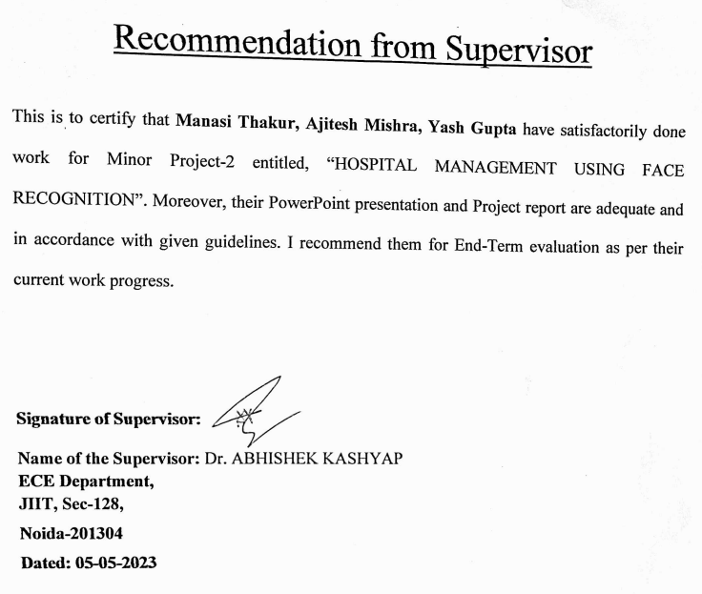
Recommendation from Supervisor

Slide 3
HOSPITAL MANAGEMENT SYSTEM
Hospital Management System provides the beneﬁts of streamlined operations, enhanced administration, control, superior patient care, strict cost control and improved proﬁtability.
HMS is powerful, ﬂexible, and easy to use and is designed and developed to deliver real conceivable beneﬁts to hospitals. More importantly it is backed by reliable and dependable support.
The project ‘Hospital Management System’ is based on the database, object-oriented and networking techniques.
Hospital Management System is custom built to meet the speciﬁc requirement of the mid and large size hospitals across the globe.

Slide 4
FACE RECOGNITION
Facial Recognition is a recognition technique used to detect faces of individuals whose images are saved in the data set.
It works by identifying and measuring facial features in an image. Facial recognition can identify human faces in images or videos, determine if the face in two images belongs to the same person, or search for a face among a large collection of existing images.
VARIOUS STEPS INVOLVED:
Step 1: Face detection
Step 2: Face analysis
Step 3: Converting the image to data
Step 4: Finding a match

Slide 5
INTRODUCTION TO MACHINE LEARNING
Machine learning is a field of computer science that gives computers the ability to learn without being explicitly programmed.
Machine learning is an application of artificial intelligence (AI) that provides systems the ability to automatically learn and improve from experience.
Algorithm to be used will be PCA(Principal Component Analysis).
There exists several other algorithms which can be brought in consideration and can be compared in order to reflect the clear choice.
The description of the algorithm are based on their real life application.

Slide 6
LITERATURE SURVEY
1. Health Management Workforce for India in 2030 [1]
Main Objective: To estimate the supply, need and requirement for health management professionals for India in the year 2030.
The overall supply capacity of trained health management professionals was 3,463 for 2017. However, based upon a service target approach India requires 11,304 health management professionals in 2017. If India is to reach the normative standards of 2.97 health managers per 100,000 population, the country would need 39,774 health management professionals in 2017. This need would increase to approximately 44,936 health management professionals by the year 2030 to maintain the normative standard of 2.97 health managers per 100,000 population.
The supply side will match the requirement of HMPs earliest by the year 2026 in a high seat occupancy scenario. Moreover, there is a need to improve the quality of the output in terms of an explicitly stated and standardized competency framework that is tailored to the Indian context.

Slide 7
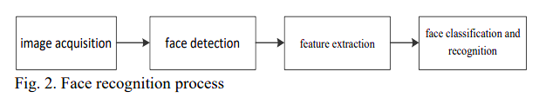
2. Research on Face Recognition Technology Based on PCA [2]
Algo used: PCA(Principal Component Analysis)
This paper expounds the basic principle and process of face recognition, and puts forward face recognition method based on PCA.
This method is used to recognize LFW (labelled faces in the wild) face data set, and the parameter adjuster named gridsearchcv is used to adjust the parameters to further improve the precision and recall of face recognition.
The experimental results show that the face recognition technology based on PCA not only reduces the dimension of face data, but also increases the recognition accuracy, which is a feasible face recognition method.
The process of face recognition is divided into four parts: image acquisition, face detection, feature extraction and face classification and recognition.
1
[2]

Slide 8
Training
Image
Face
Detection
Normalization
Feature
Extraction
Model
Testing
Image
Face
Detection
Normalization
Feature
Extraction
Classification
Face
Identified
Fig. 2(b) Stages of the process of facial recognition [2]

Slide 9
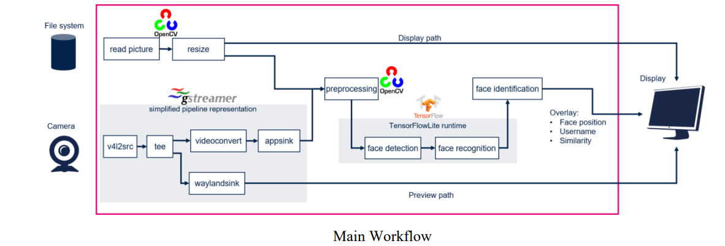
3.Integration of Flask and Python on The Face Recognition Based Attendance System. [4]
Face recognition has been around for a while, but in recent years it has become increasingly widely used. This is because machine learning has improved deep learning and allowed systems to analyses vast amounts of data more quickly.
The research paper provides an introduction to the associated facial recognition and interface using flask and sql alchemy technologies. The research discusses the many stages of development and associated technologies used like PCA
With the python library, we can write a few lines of code to include email sending capabilities to your application and sidestep using the cumbersome traditional approaches.
Fig. 3 Main Workflow [4]

Slide 10
4. Performance Comparison and Evaluation of Web Development Technologies in PHP, Python and Node.js [5]
This paper focuses on the impact on Web performance from three different Web technologies: Node.js, PHP and Python-Web.
By means of benchmark tests and scenario tests, we can evaluate performance from both objective systematic tests (benchmark) and realistic user behavior tests (scenario).
To sum up, PHP is applicable to small scale but noncompute-intensive site, while Node.js is more suitable for the IO-intensive and more users’ website.
Although Python isn’t suitable for the compute-intensive and IO-intensive website, it’s maybe the best choice for developers to build large websites due to lots of famous companies like google use it.
Node.js can quickly response to IO-requests since its own mechanism. It uses event model based on asynchronous IO, not like multi-processor, responding rapidly.

Slide 11
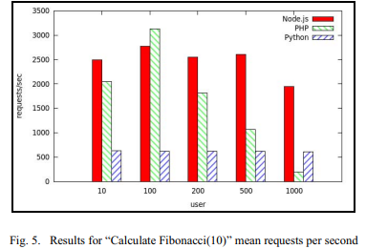
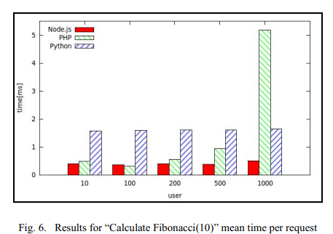
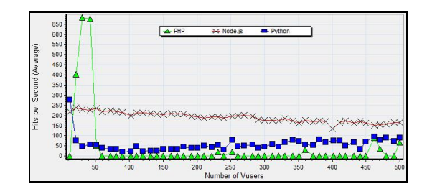
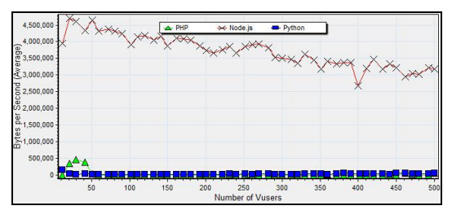
Fig. 4 Performance results [5]

Slide 12
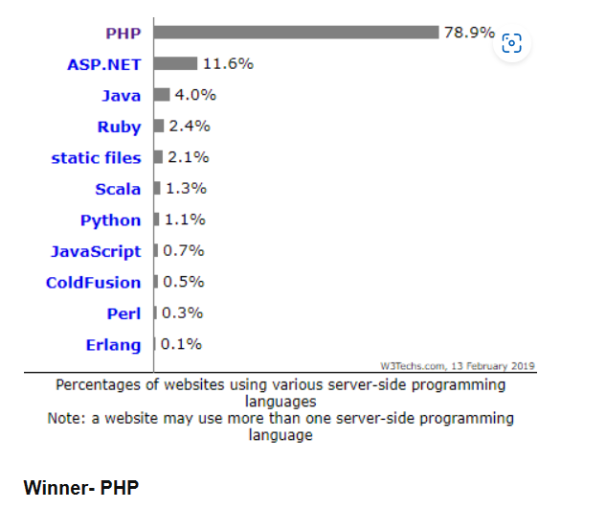
PHP vs other lang
Fig. 5 PHP vs other lang [4]

Slide 13
Framework Considered:
Django
Flask
Fast:Django working process from concept to completion is extremely fast.
Versatile:Django is a versatile framework that enables developers to work on different platforms varying from content management systems like WordPress, etc, to social network sites like LinkedIn, Youtube, etc, to news sites like The New York Times, CNN, etc.
Adaptable: Django is adaptable to different formats like JSON, HTML, XML, and many more.
Portable: Django is a python-based framework and, therefore, portable.
Lightweight: It is a lightweight framework as it is independent of external libraries. It gives a quick start to the web development process of complex applications.
Independent: Flask gives independent or full control to the developer for creating applications. You can experiment with the architecture or the libraries of the framework.
It comes with a built-in server and debugger.
Compatible: Flask is compatible with the latest technologies like Machine Learning, Cloud, etc.
Vs

Slide 14

LANGUAGES CONSIDERED:
Python
PHP
Ruby
Python is an interpreted high-level, general-purpose programming language. Its construction and its object-oriented approach helps Python developers provide logical code, clear and concise codes for small and large-scale projects.
Integration with Java, C, and C++ programming code.
Interactive testing and debugging sessions.
Ruby is a dynamic, open-source, high-level programming language with a core focus on simplicity and productivity.
Ready-to-use components of code, facilitating the implementation of different features; as a result, the app code is clean and has high readability.
PHP is a general-purpose scripting language specifically geared towards web development.
Open source and free from cost. It can be downloaded anywhere and is readily available to use for web applications.
PHP-based applications can function on any OS such as UNIX, Linux and Windows, etc.
Built-in database connection modules to seamlessly connect the database.
Vs
Vs

Slide 15
PROBLEM STATEMENT
The current system in use is a paper-based system. It is too slow and cannot provide updated lists of patients within a reasonable timeframe.
In the current scenario most of the hospitals are managing their day-to day working manually which makes its working prone to human errors which if ignored may cost someone's life. No solid existing application for the particular sector.
Recording and maintaining all these records is a very tedious and error prone task . It is also not very economical and technically feasible way to manage records of patients.
Thus this project aims to completely replace the current manual system with an economical and technically advanced system for a hassle free management of the hospital.
The project aims to solve the problem of maintaining the record of each patient following which the entire medical history of the patient will be available in the hospital database . The doctor now has access to all the medical treatments the patient has undergone and allergies possessed if any.

Slide 16
OBJECTIVE
Efficient and accurate administration of finance, diet of patient and distribution of medical aid. It helps to view a broad picture of hospital growth.
Enhances information integrity, reduces transcription errors, and reduces duplication of information entries.
Hospital software is easy to use and eliminates error caused by handwriting.
A comprehensive, integrated a hospital management software designed to manage all the aspects of a hospital operations.

Slide 17
SCOPE OF THE PROJECT
GLOBAL
The proposed software product is the Hospital Management System (HMS).
The system will be used in any Hospital, Clinic, Dispensary or Pathology labs, application truly hands on and easy to use
Easy to get the information from the patients and then storing that data for future usage.
The intentions of the system are to reduce over-time pay and increase the number of patients that can be treated accurately.
Systematic management of data.
Application truly indigenous.
Aims to all classes and sectors of the society.
Better Security.
Quicker Processing
Seamless Integration

Slide 18
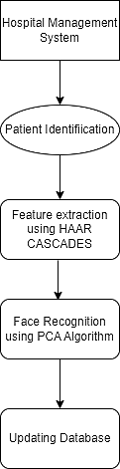
PROPOSED SYSTEM
Fig 6(a) Systematic flow of the proposed system

Slide 19
PROPOSED FLOW CHART
Start
Import Necessary
Packages
Fetch the data from the data set
Filter the data
Fit the model
Proposed model
Predict the result
Stop
Fig 6(b) Flowchart of the proposed system

Slide 20
ALGORITHMS CONSIDERED:
Principal Component Analysis (PCA)
Local Binary Pattern Histogram (LBPH)
Vs
reduce the dimensionality within a dataset while still retaining as much information as possible.
Accuracy rate : >90%
can recognize both front face and side face
the recognition rate of LBPH algorithm is very less under specific illumination
Accuracy rate : 78%

Slide 21
ADVANTAGES OF PCA Over Other algorithm
ORTHOGONAL
Principal components are orthogonal
ADVANTAGES OF PCA
REDUCE DIMENSIONALITY
After reduction have no influence on each other
EIGENVALUE DECOMPOSITION
calculation using this method is simple
FASTER
Speeds up over other machine learning algorithms

Slide 22
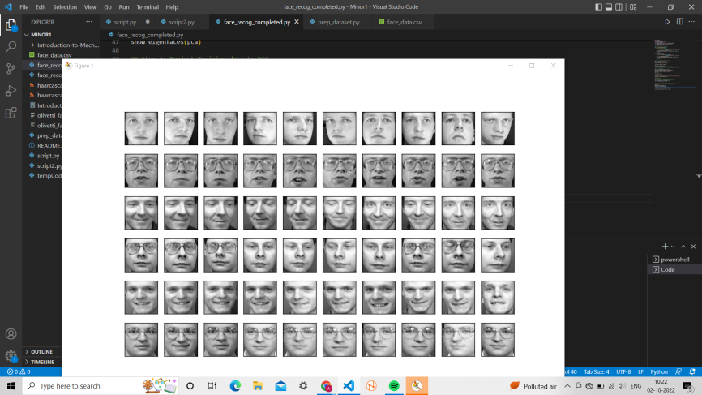
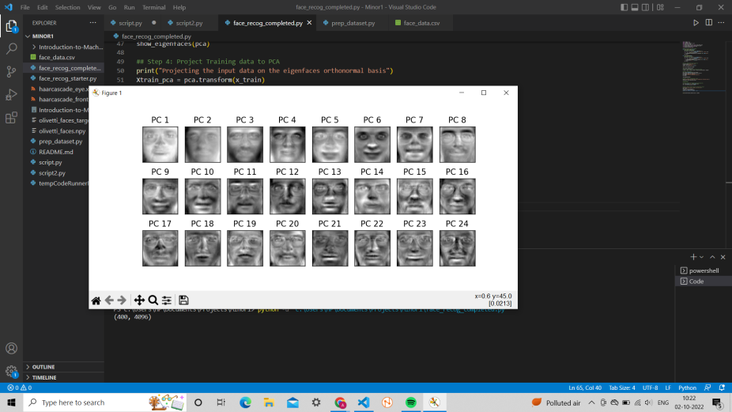
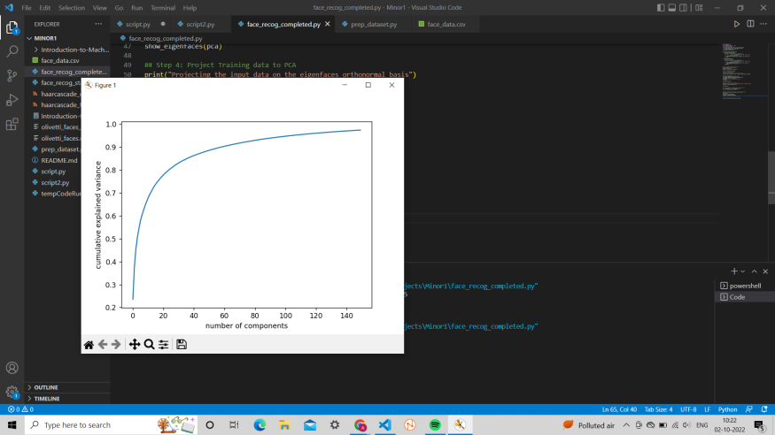

OUTPUTS
Fig. 7(a)Training Dataset Images Fig. 7(b) Eigen Faces
Fig. 7(c) Accuracy Graph Fig. 7(d) Training Output

Slide 23
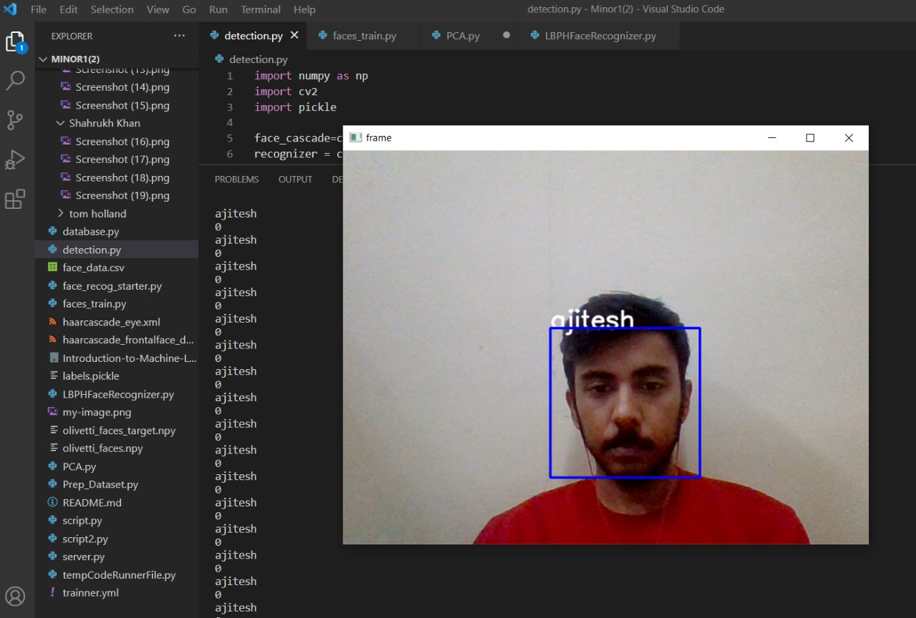
Outputs
Fig. 7(e) Output of patient recognition

Slide 24
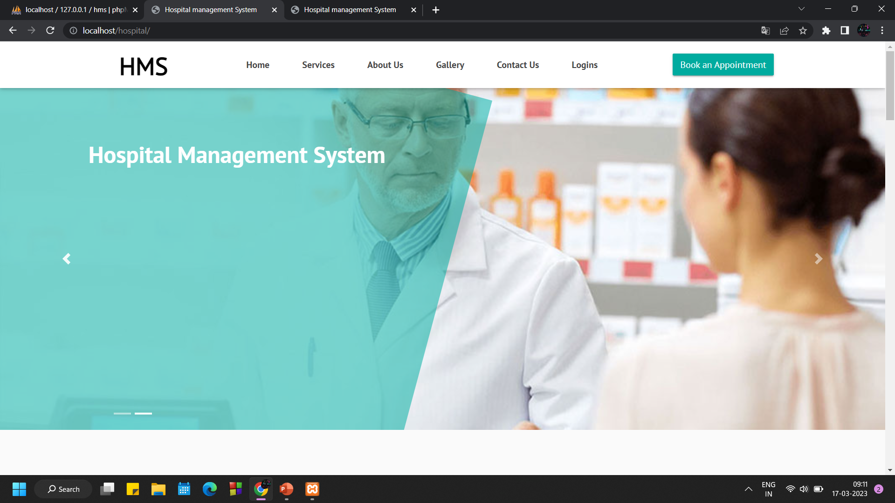
Outputs
Fig 8(a) : Index Page

Slide 25
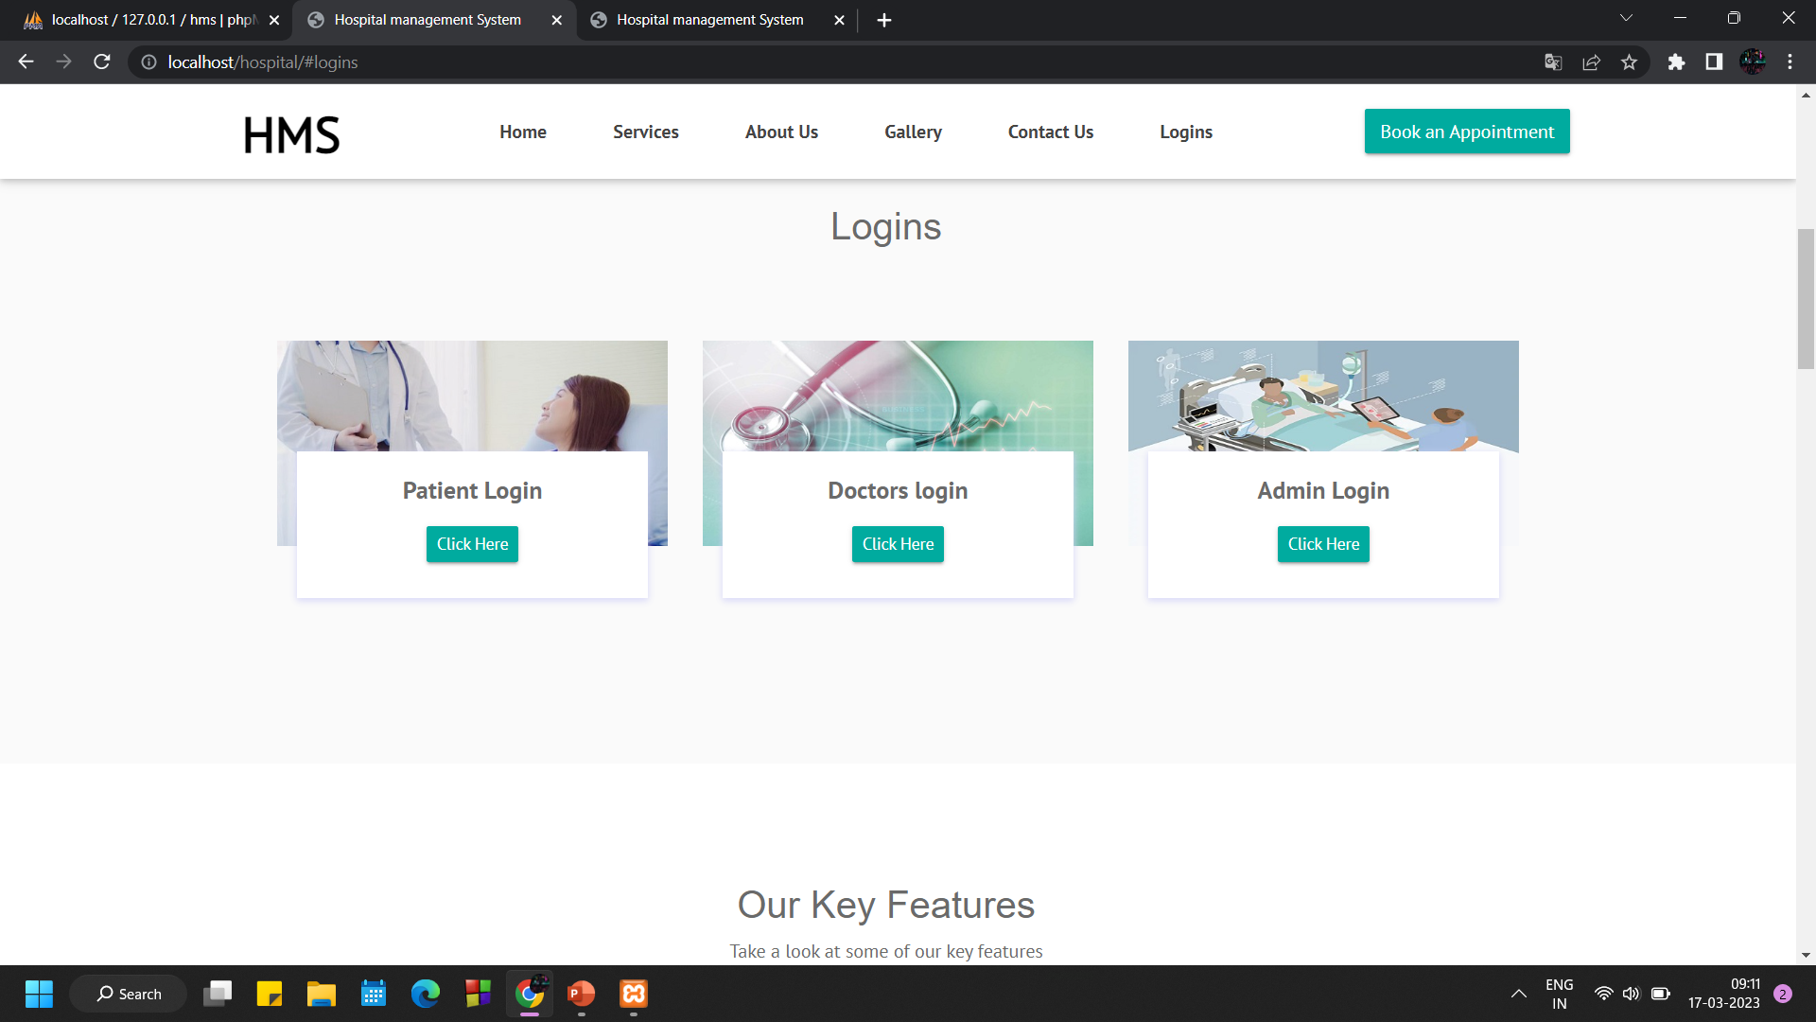
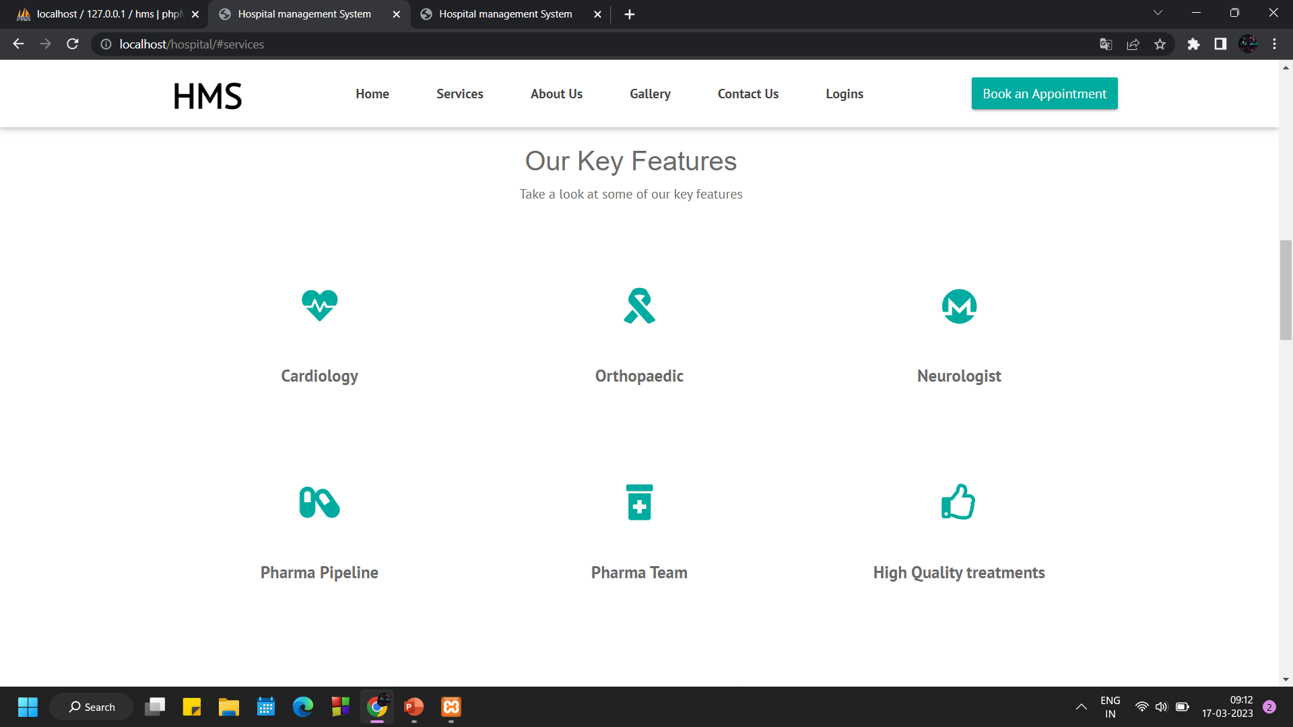
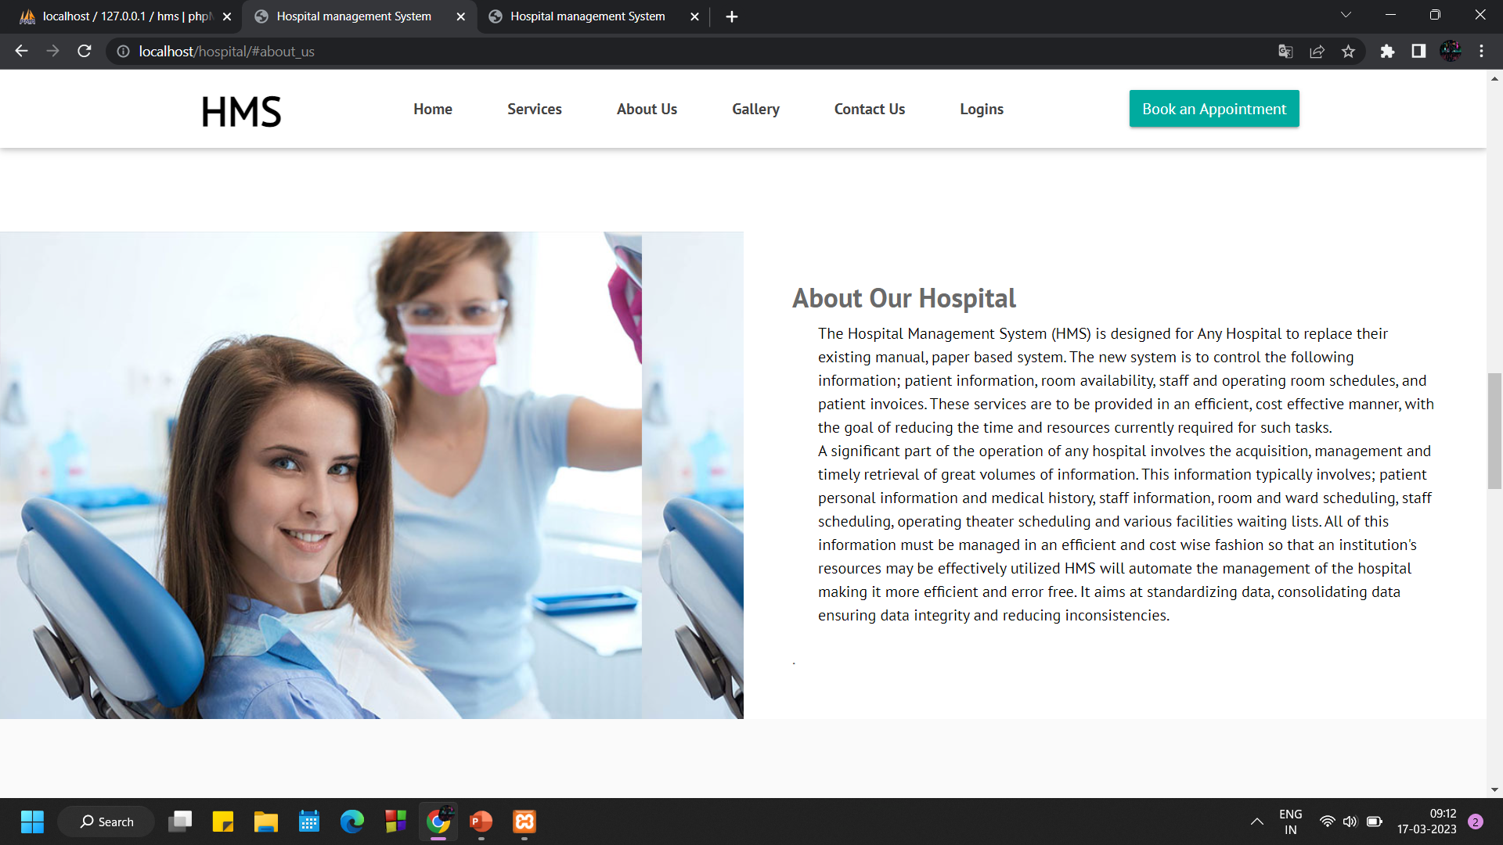
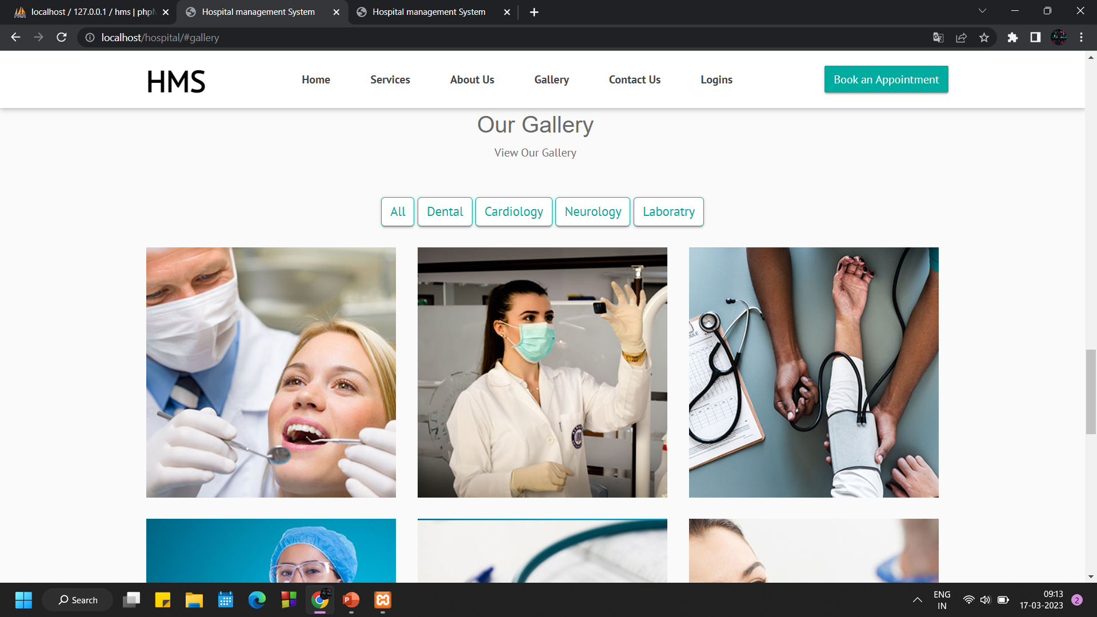
Outputs
Fig 8(b) : Login Page
Fig 8(c) : Services Page
Fig 8(d) : About-us Page
Fig 8(e) : Gallery Page

Slide 26
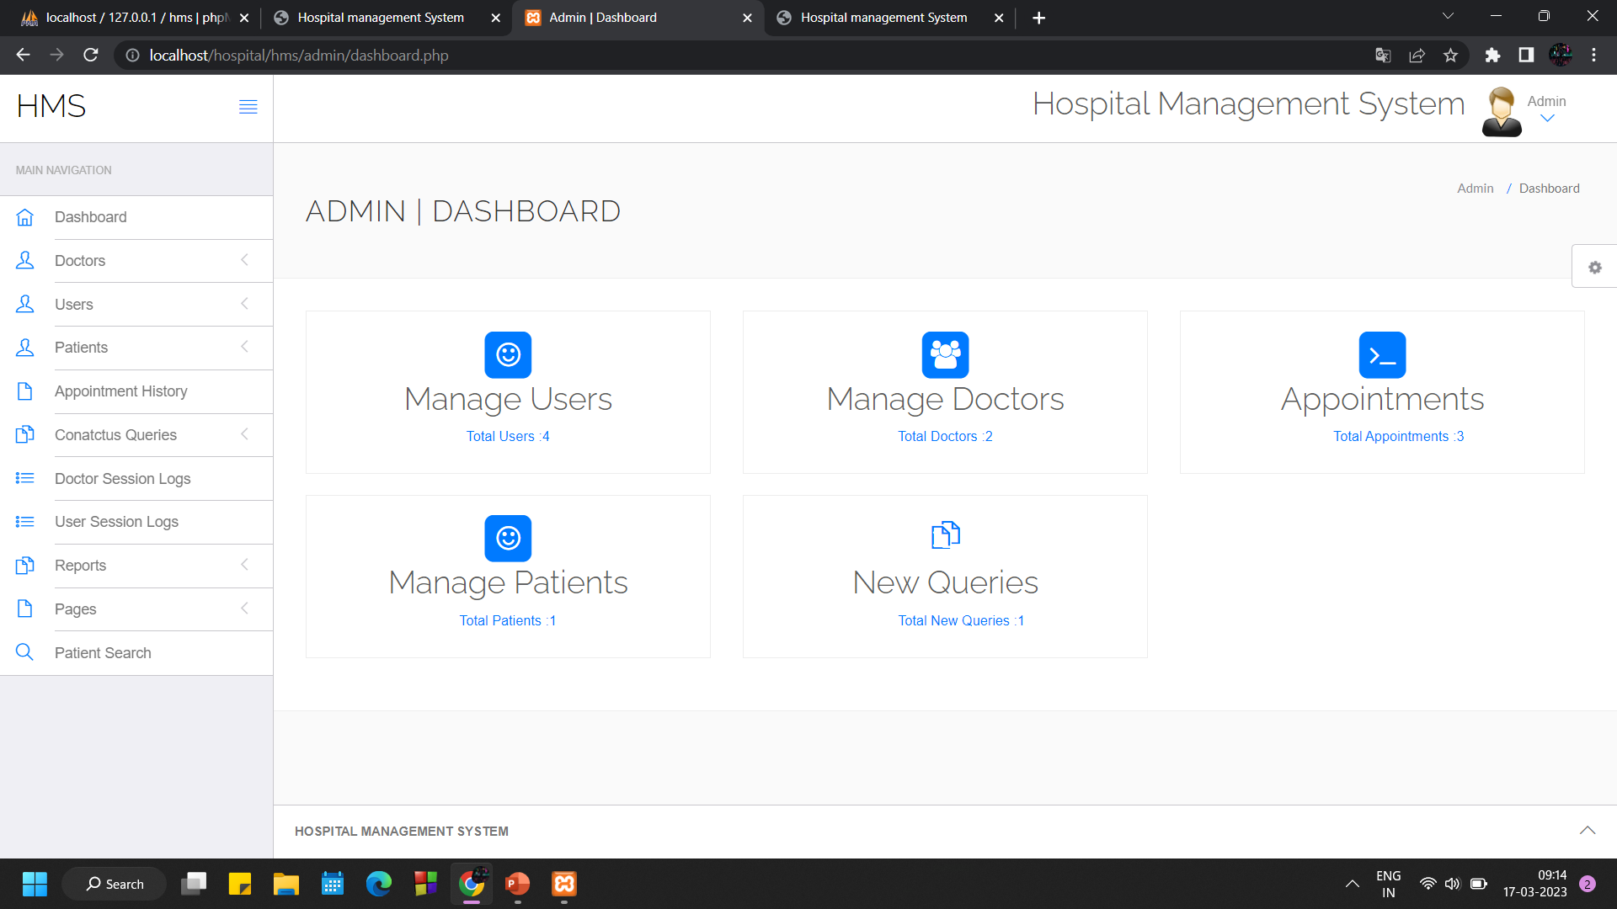
Outputs
Fig 8(e) : Admin Panel

Slide 27
REFERENCES
[1] Y. Wang and Q. Wu, "Research on Face Recognition Technology Based on PCA and SVM," 2022 7th International Conference on Big Data Analytics (ICBDA), 2022, pp. 248-252,
doi: 10.1109/ICBDA55095.2022.9760320.
[2] E. I. Abbas, M. E. Safi and K. S. Rijab, "Face recognition rate using different classifier methods based on PCA," 2017 International Conference on Current Research in Computer Science and Information Technology (ICCIT), 2017, pp. 37-40, doi: 10.1109/CRCSIT.2017.7965559.
[3] Aggarwal, Himanshu. “Study and Comparison of Various Image Edge Detection Techniques.” International Journal of Image Processing … (2009): n. pag. Print.
[4] C. A. Trianti, B. Kristianto and Hendry, "Integration of Flask and Python on The Face Recognition Based Attendance System," 2021 2nd International Conference on Innovative and Creative Information Technology (ICITech), Salatiga, Indonesia, 2021, pp. 164-168, doi: 10.1109/ICITech50181.2021.9590122.
[5] K. Lei, Y. Ma and Z. Tan, "Performance Comparison and Evaluation of Web Development Technologies in PHP, Python, and Node.js," 2014 IEEE 17th International Conference on Computational Science and Engineering, Chengdu, China, 2014, pp. 661-668, doi: 10.1109/CSE.2014.142.

